Slide 1

CytoAutoCluster
Enhancing Cytometry with Deep Learning
- Aniket Rahile

Slide 2
Introduction and Problem Statement
Context: Cytometry produces large, complex datasets critical for understanding immune profiles, but traditional clustering struggles with high dimensionality.
Challenges:
Limited labeled data for supervised models.
Biological variability adds noise.
Objective: Develop a scalable semi-supervised framework to improve clustering accuracy and reduce dependency on labeled data.
Key Insight:
Semi-supervised clustering techniques, including autoencoder-based feature learning, provide a promising solution to tackle these challenges and validate against manually gated clusters.
implicates interpretation and hampers efficiency
.Limited labeled data restricts the application of supervised models.Biological variability introduces noise and inconsistency, further complicating analysis.

Slide 3
Dataset Overview
The Levine_32dim.csv dataset comprises 265,627 samples measured across 32 distinct markers. It serves as a critical resource for cytometry-based clustering and immune profiling research. The data is partially labeled, with 39% (104,184 samples) belonging to 14 manually identified clusters, while the remaining 61% (161,443 samples) are unlabeled, presenting challenges for unsupervised learning.
Key Highlights:
Dimensionality: 32 markers represent various biological attributes, including DNA, viability, and immune cell markers.
Label Distribution: A significant portion of the dataset remains unlabeled, necessitating advanced semi-supervised learning techniques to maximize interpretability and clustering accuracy.
Source: This dataset, sourced from Levine et al. (2015), is publicly accessible and widely used as a benchmark for clustering studies.
This dataset’s complexity underscores the importance of scalable frameworks capable of handling high-dimensional, partially labeled data.

Slide 4
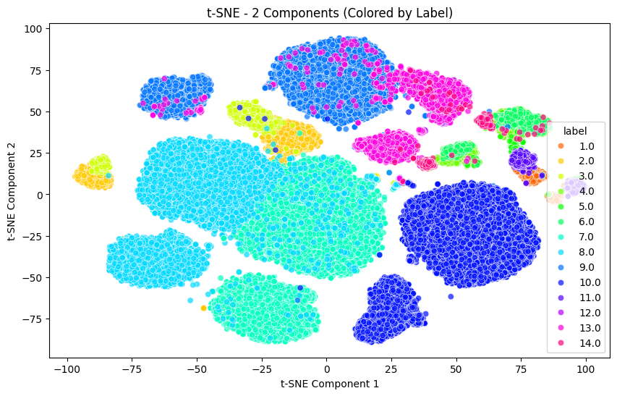
Methodology
Data Preprocessing
StandardScaler used for feature normalization.
Dataset partitioned into labeled (39%) and unlabeled (61%) subsets.
Semi-Supervised Learning
Autoencoder trained to reduce dimensionality and handle missing labels.
Combined loss (Binary Cross-Entropy & Mean Squared Error) balances supervised and unsupervised tasks.
Dimensionality Reduction
t-SNE applied for 2D visualization of clusters.
Clustering
Semi-supervised techniques used to enhance unlabeled data clustering guided by labeled subsets.
t-sne before model implementation

Slide 5
Model Architecture
The model uses an autoencoder-based architecture in a semi-supervised framework:
Autoencoder Structure
Encoder compresses data into a lower-dimensional space.
Decoder reconstructs it to retain key features.
Loss function combines Binary Cross-Entropy and MSE.
Semi-Supervised Approach
Leverages both labeled and unlabeled data to enhance clustering accuracy.
Output
Generates reliable clusters while minimizing the need for manual labeling.
This architecture enables effective clustering and feature extraction for high-dimensional cytometry data.

Slide 6
Model Evaluation and Results
Logistic Regression:
Probabilities: Logistic Regression outputs probabilities for each class, which are close to zero for most classes, with higher probabilities for the correct class.
Log Loss: The Log Loss of 0.022 indicates good predictive performance, with lower values indicating fewer errors in classification.
XGBoost:
Probabilities: XGBoost probabilities also show a strong confidence in the correct class predictions, with a similar pattern of low probabilities for incorrect classes.
Log Loss: The Log Loss of 0.043, while slightly higher than Logistic Regression, still indicates strong model performance.
Performance Metrics:
Accuracy: Achieved an accuracy of 94.05%, which demonstrates that the model correctly predicted the class for the majority of samples.
AUROC: With an AUROC of 0.9987, both models show excellent discriminatory ability, distinguishing between classes with high precision.

Slide 7
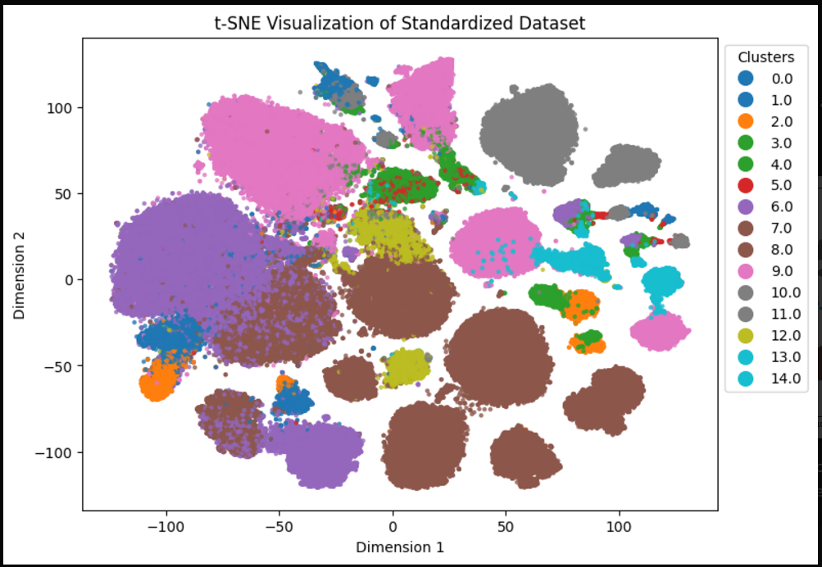
Model Evaluation and Results
The t-SNE plot displays the results of clustering the cytometry data using a semi-supervised approach.
Each color represents a distinct cluster, with the points arranged based on high-dimensional data relationships.
The model successfully grouped the data, highlighting clear separation and structure within the unlabeled cells, demonstrating the effectiveness of the clustering algorithm.
t-sne after model implementation

Slide 8
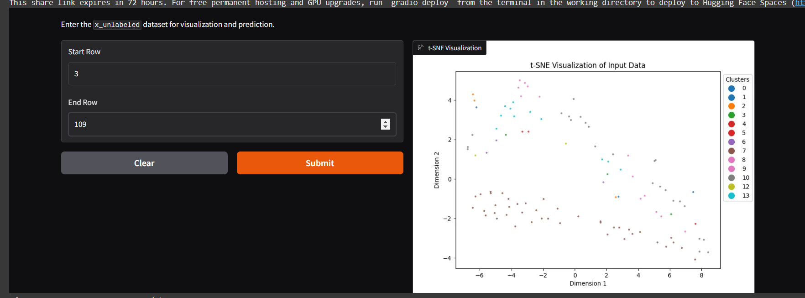
Gradio Interface for User Interaction
A Gradio interface was implemented to facilitate easy interaction with the model.
Users can upload new datasets or interact with the model’s predictions directly.
The interface allows real-time visualization of t-SNE plots, model predictions, and clustering results.
Provides a simple way to explore the effectiveness of the semi-supervised clustering approach for cytometry data without requiring any coding.

Slide 9
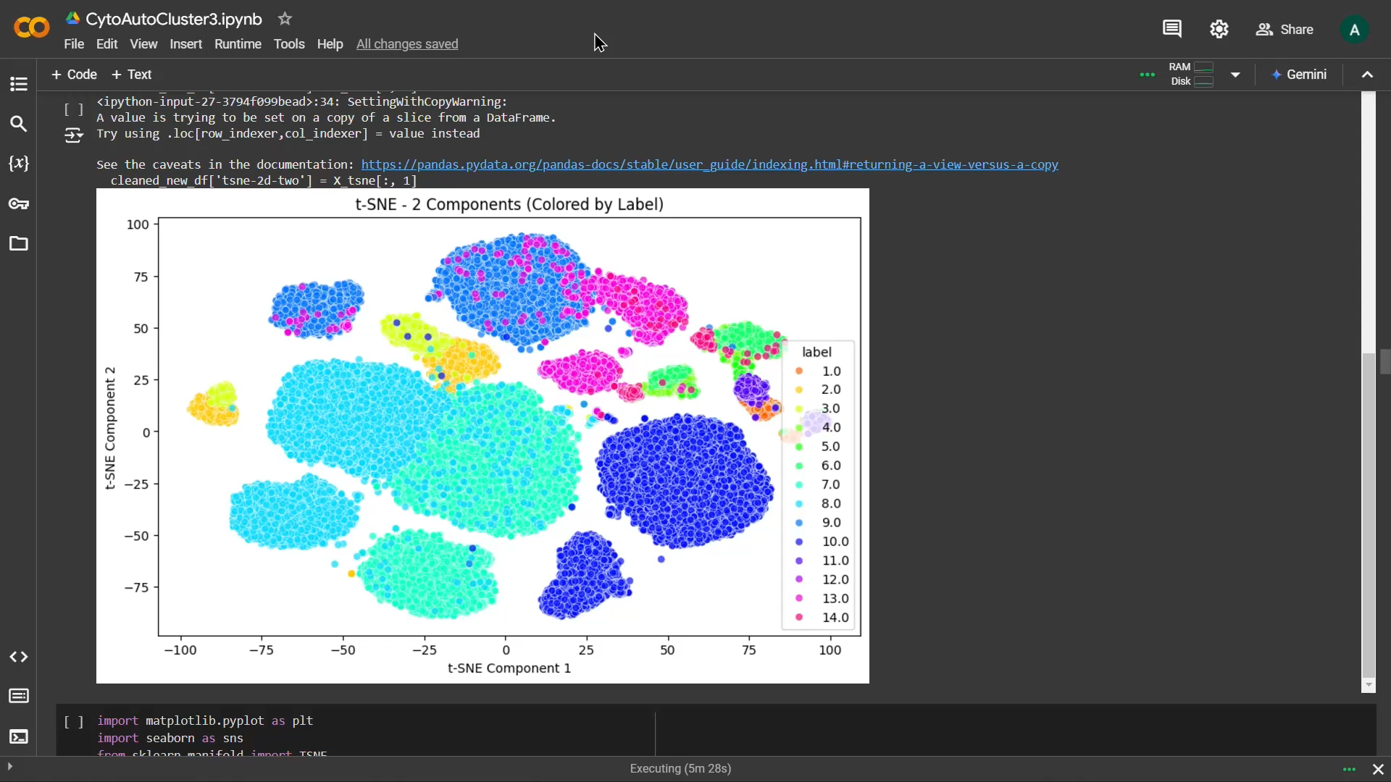
Demo of Gradio Interface

Slide 10
Thank you
- Aniket Rahile

